Slide 1
SUFFIX TREE - O(n)
APS-PROJECT
SUBMITTED BY: PULKIT SHARMA
ASHISH KEMPWAD

Slide 2
SUFFIX TREE - O(n)
It is compressed trie
Its is also known as position tree
Mostly used for fast implementation of string operations

Slide 3
Definition:
A suffix tree is a patricia tree of the suffix trie
#What is implicit suffix tree?
The implicit suffix tree of a string is what results by applying Ukkonen’s algorithm to the string without an added end marker $

Slide 4
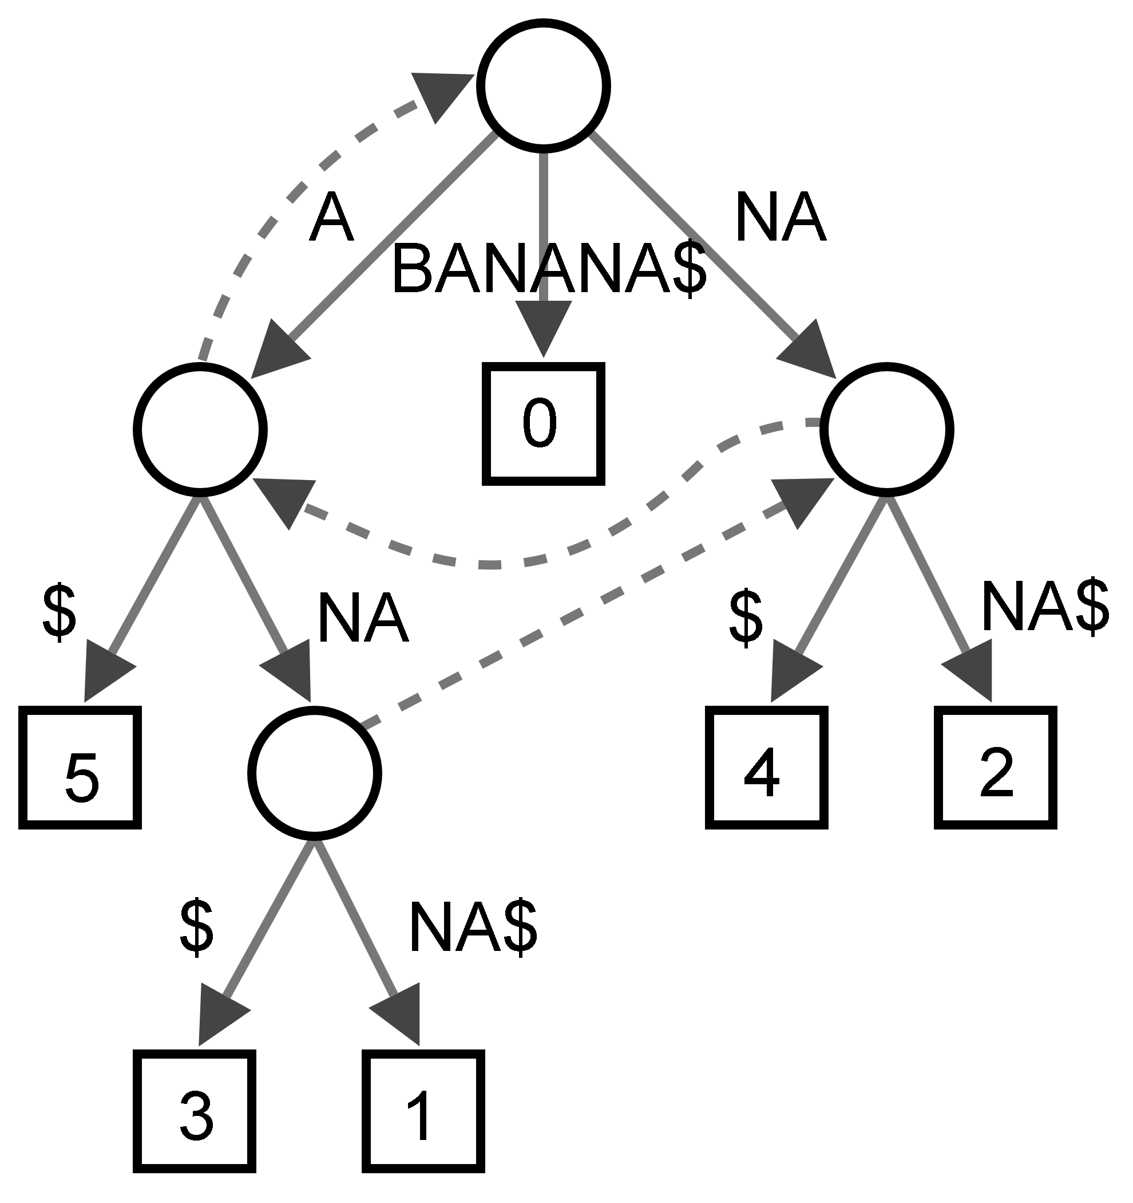
Representation of suffix tree

Slide 5
Definition and key points
The tree has exactly n leaves numbered from 1 to n.
Each edge is labelled with a non-empty substring of S.
No two edges starting out of a node can have string-labels beginning with the same character.
The string obtained by concatenating all the string-labels found on the path from the root to leaf ‘i' spells out suffix S[i..n], for i from 1 to n.
Since such a tree does not exist for all strings, S is padded with a terminal symbol not seen in the string .This ensures that no suffix is a prefix of another, and that there will be n leaf nodes, one for each of the n suffixes of S.

Slide 6
Basics about Ukkonen’s algorithm
Suffix links:-
For every internal node v, with path tα( where t is single character and α is zero or more character strings) there is another internal node sv with α which is suffix link of v(If α is NULL, suffix link is root).
WHY Suffix Link is important?
-> Because it helps us to traverse between the nodes quickly which will help us improve our runtime.
HOW do we create suffix link?
->When a new internal node is created during an extension of phase and a new internal node is created during next extension of same phase , then that new internal node will be the suffix link of older internal node.

Slide 7
TRICKS USED
->SKIP/COUNT:
EDGE LABEL COMPRESSION:-
Instead of storing actual characters on edge , we are storing range indexes in input array.
->RULE 3 EXTENSION IS A SHOWSTOPPER
When a suffix already occur in tree then that’s when rule 3 extension happens i.e. stop the current phase and start the next phase.
-> GLOBAL END FOR THE LEAVES
We maintain end pointer for globally incrementing leaves.

Slide 8
UKKONEN Algorithm
The naive implementation for generating a suffix tree going forward requires O(n²) or even O(n³) time complexity in bigO notation, where n is the length of the string. By exploiting a number of algorithmic techniques, Ukkonen reduced this to O(n) (linear) time, for constant-size alphabets, and O(n log n) in general, matching the runtime performance of the earlier two algorithms.
The algorithm begins with an implicit suffix tree containing the first character of the string. Then it steps through the string adding successive characters until the tree is complete. This order addition of characters gives Ukkonen's algorithm its "on-line" property. The original algorithm presented by Peter Weiner proceeded backward from the last character to the first one from the shortest to the longest suffix . A simpler algorithm was found by Edward M.McCreight, going from the longest to the shortest suffix.

Slide 9
There are 3 extension rules:-
Rule 1: If the path from the root labelled S[j..i] ends at leaf edge (i.e. S[i] is last character on leaf edge) then character S[i+1] is just added to the end of the label on that leaf edge.
Rule 2: If the path from the root labelled S[j..i] ends at non-leaf edge (i.e. there are more characters after S[i] on path) and next character is not s[i+1], then a new leaf edge with label s[i+1] and number j is created starting from character S[i+1]. A new internal node will also be created if s[1..i] ends inside (in-between) a non-leaf edge.
Rule 3: If the path from the root labelled S[j..i] ends at non-leaf edge (i.e. there are more characters after S[i] on path) and next character is s[i+1] (already in tree), do nothing.
Ukkonen’s algorithm Construct tree T₁ For i from 1 to m-1 do begin {phase i+1} For j from 1 to i+1 begin {extension j} Find the end of the path from the root labelled S[j..i] in the current tree. Extend that path by adding character S[i+l] if it is not there already end; end;

Slide 10
SOME MORE THINGS
->Active points:
It is a point from which a new extension will start.
-Active node
-Active edge
-Active length
There are rules of active points:
->If active length is zero, then we are going to start next extension or next phase from root.
->If we are moving on same edge(at rule 3 extension)we increment our active length by 1 and if we are jumping internal node, then reset the active length, edge, node accordingly.

Slide 11
->We check if active node is root(at rule 2 extension) so we just decrement our active length by 1 and increment our active edge by 1, now we reach that location.
->Now when active length becomes zero, then by the rule of active point we check if there is a path from root or not and if not create one.
->Now as we checked active node was root so if active node was not root, then we follow suffix link and reach to that location and from this location we check is there a path now , if no we create new leaf with path and change active node.

Slide 12
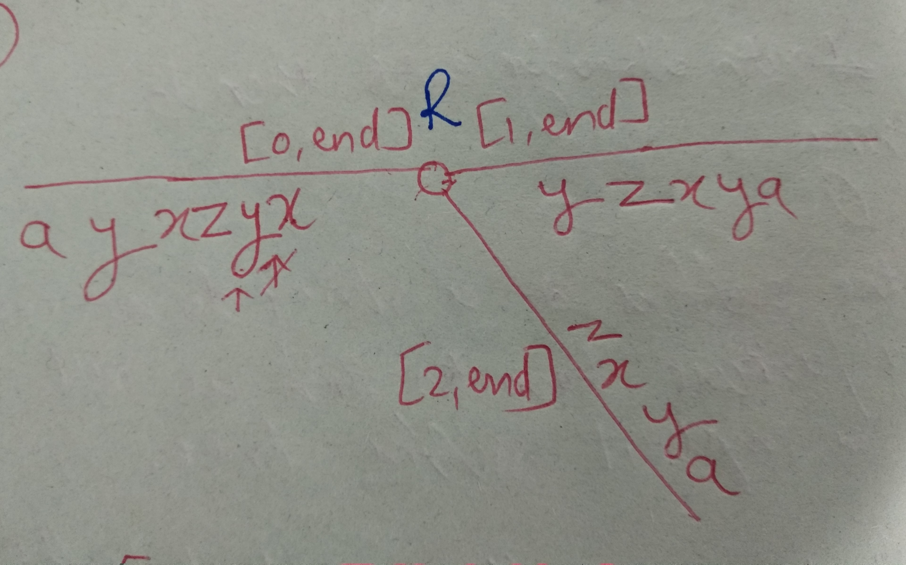
Representation of Ukkonen
Let the string be : xyzxyaxyz$
Step 1:

Slide 13
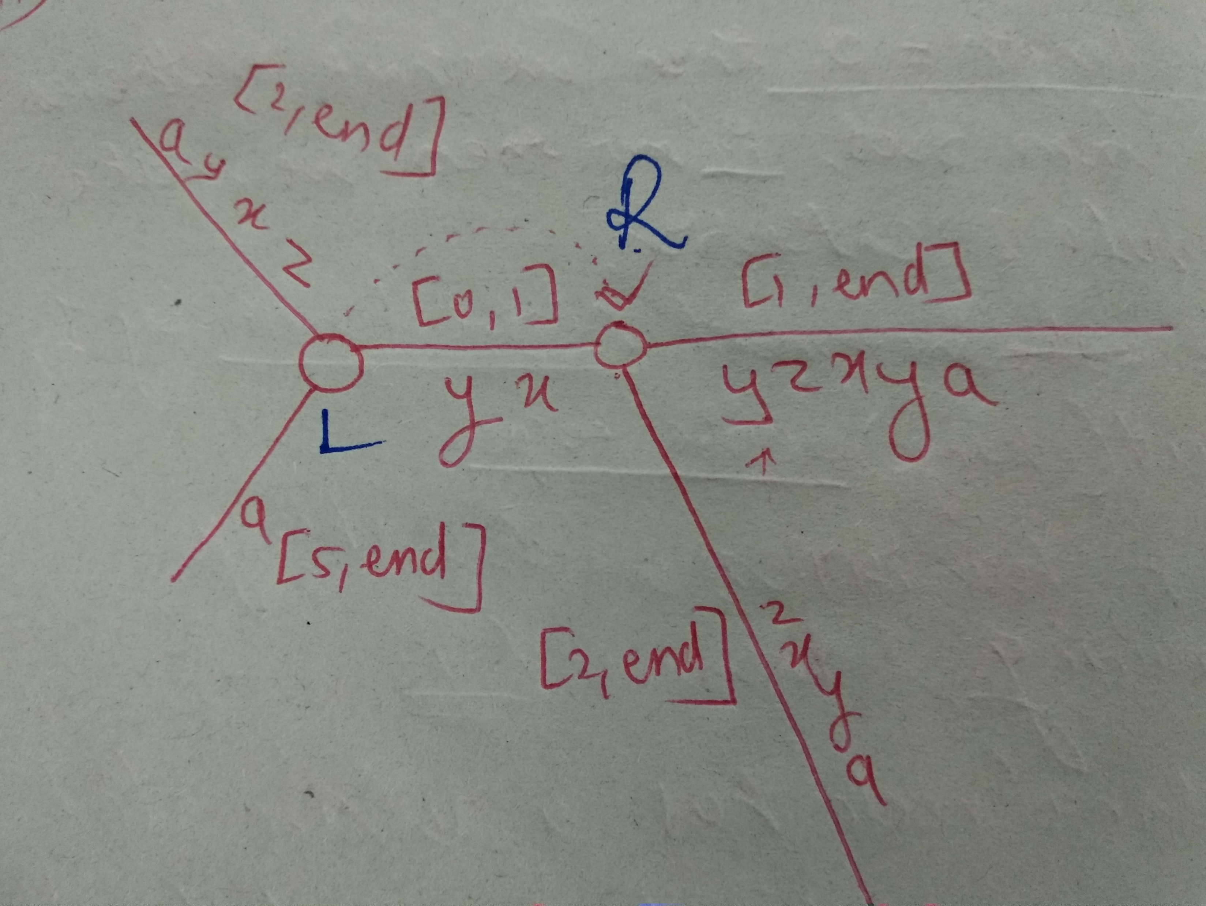
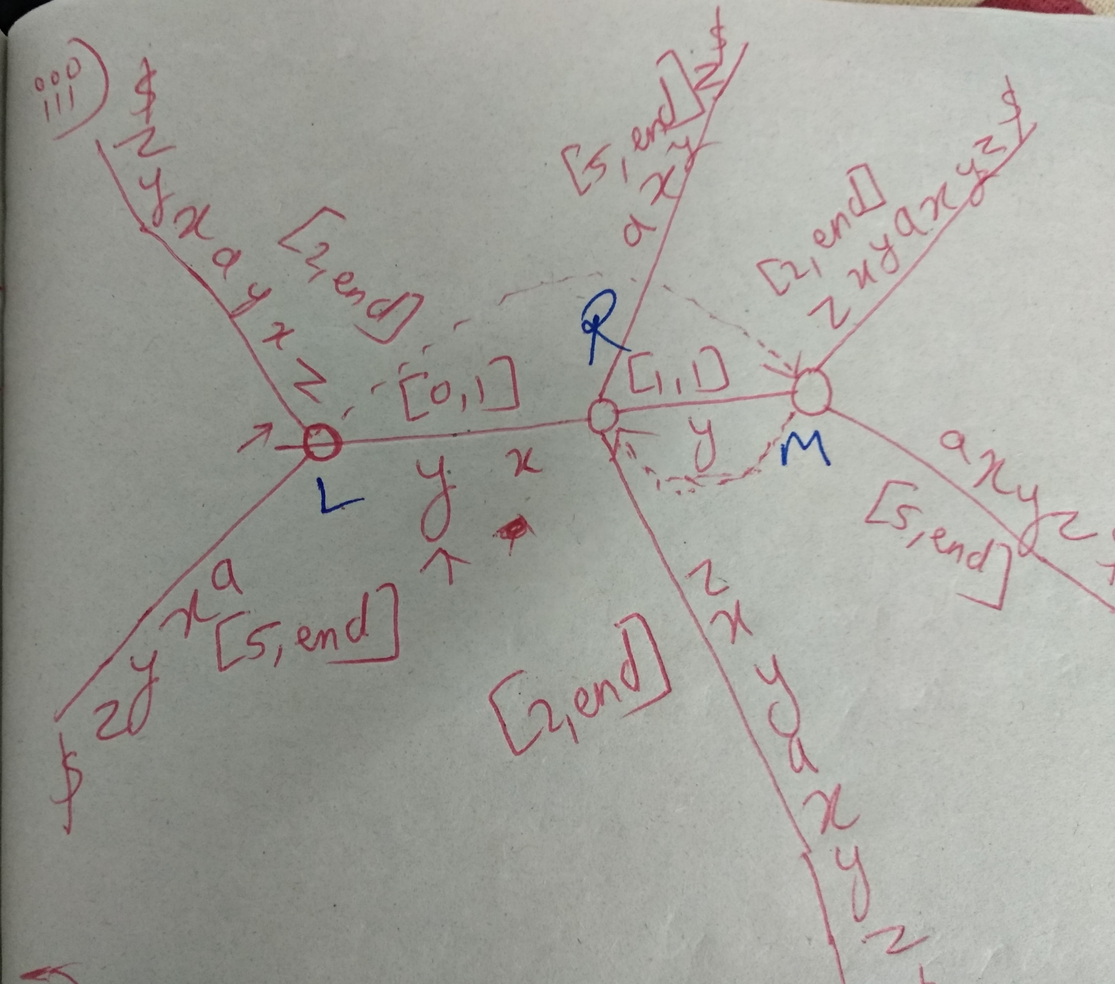
Step 2 Step 3

Slide 14
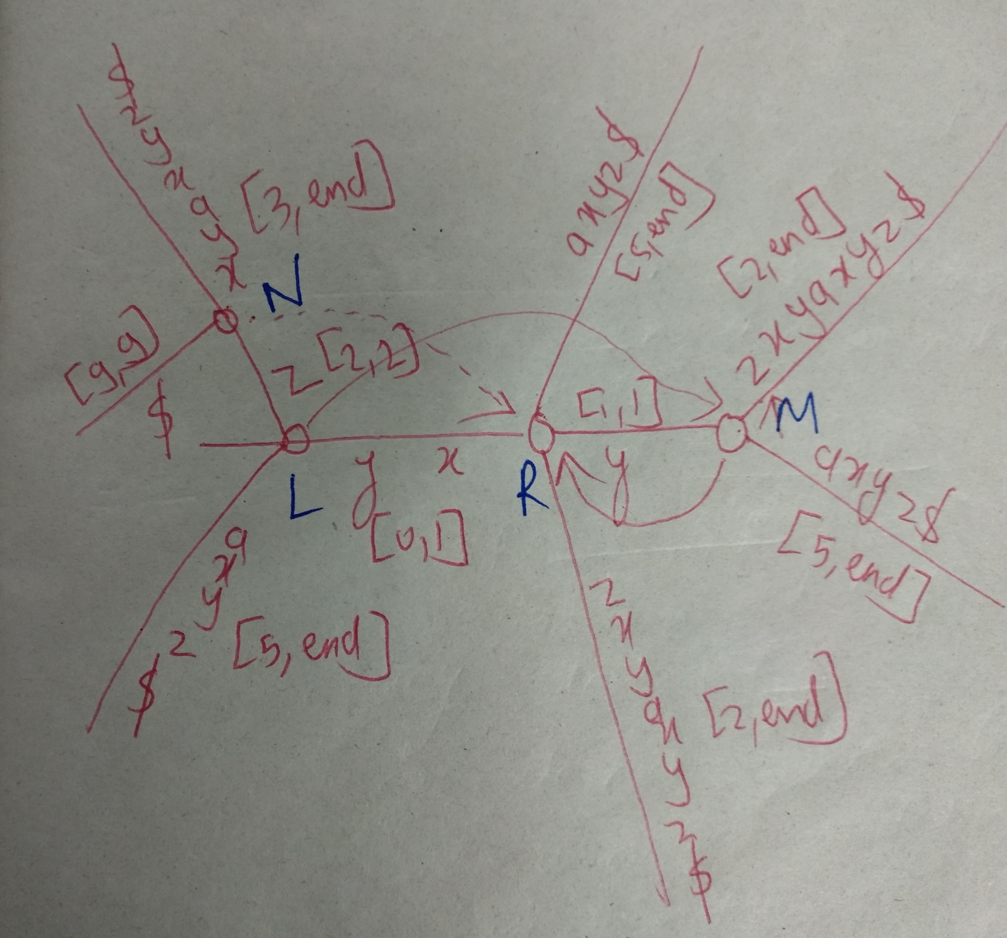
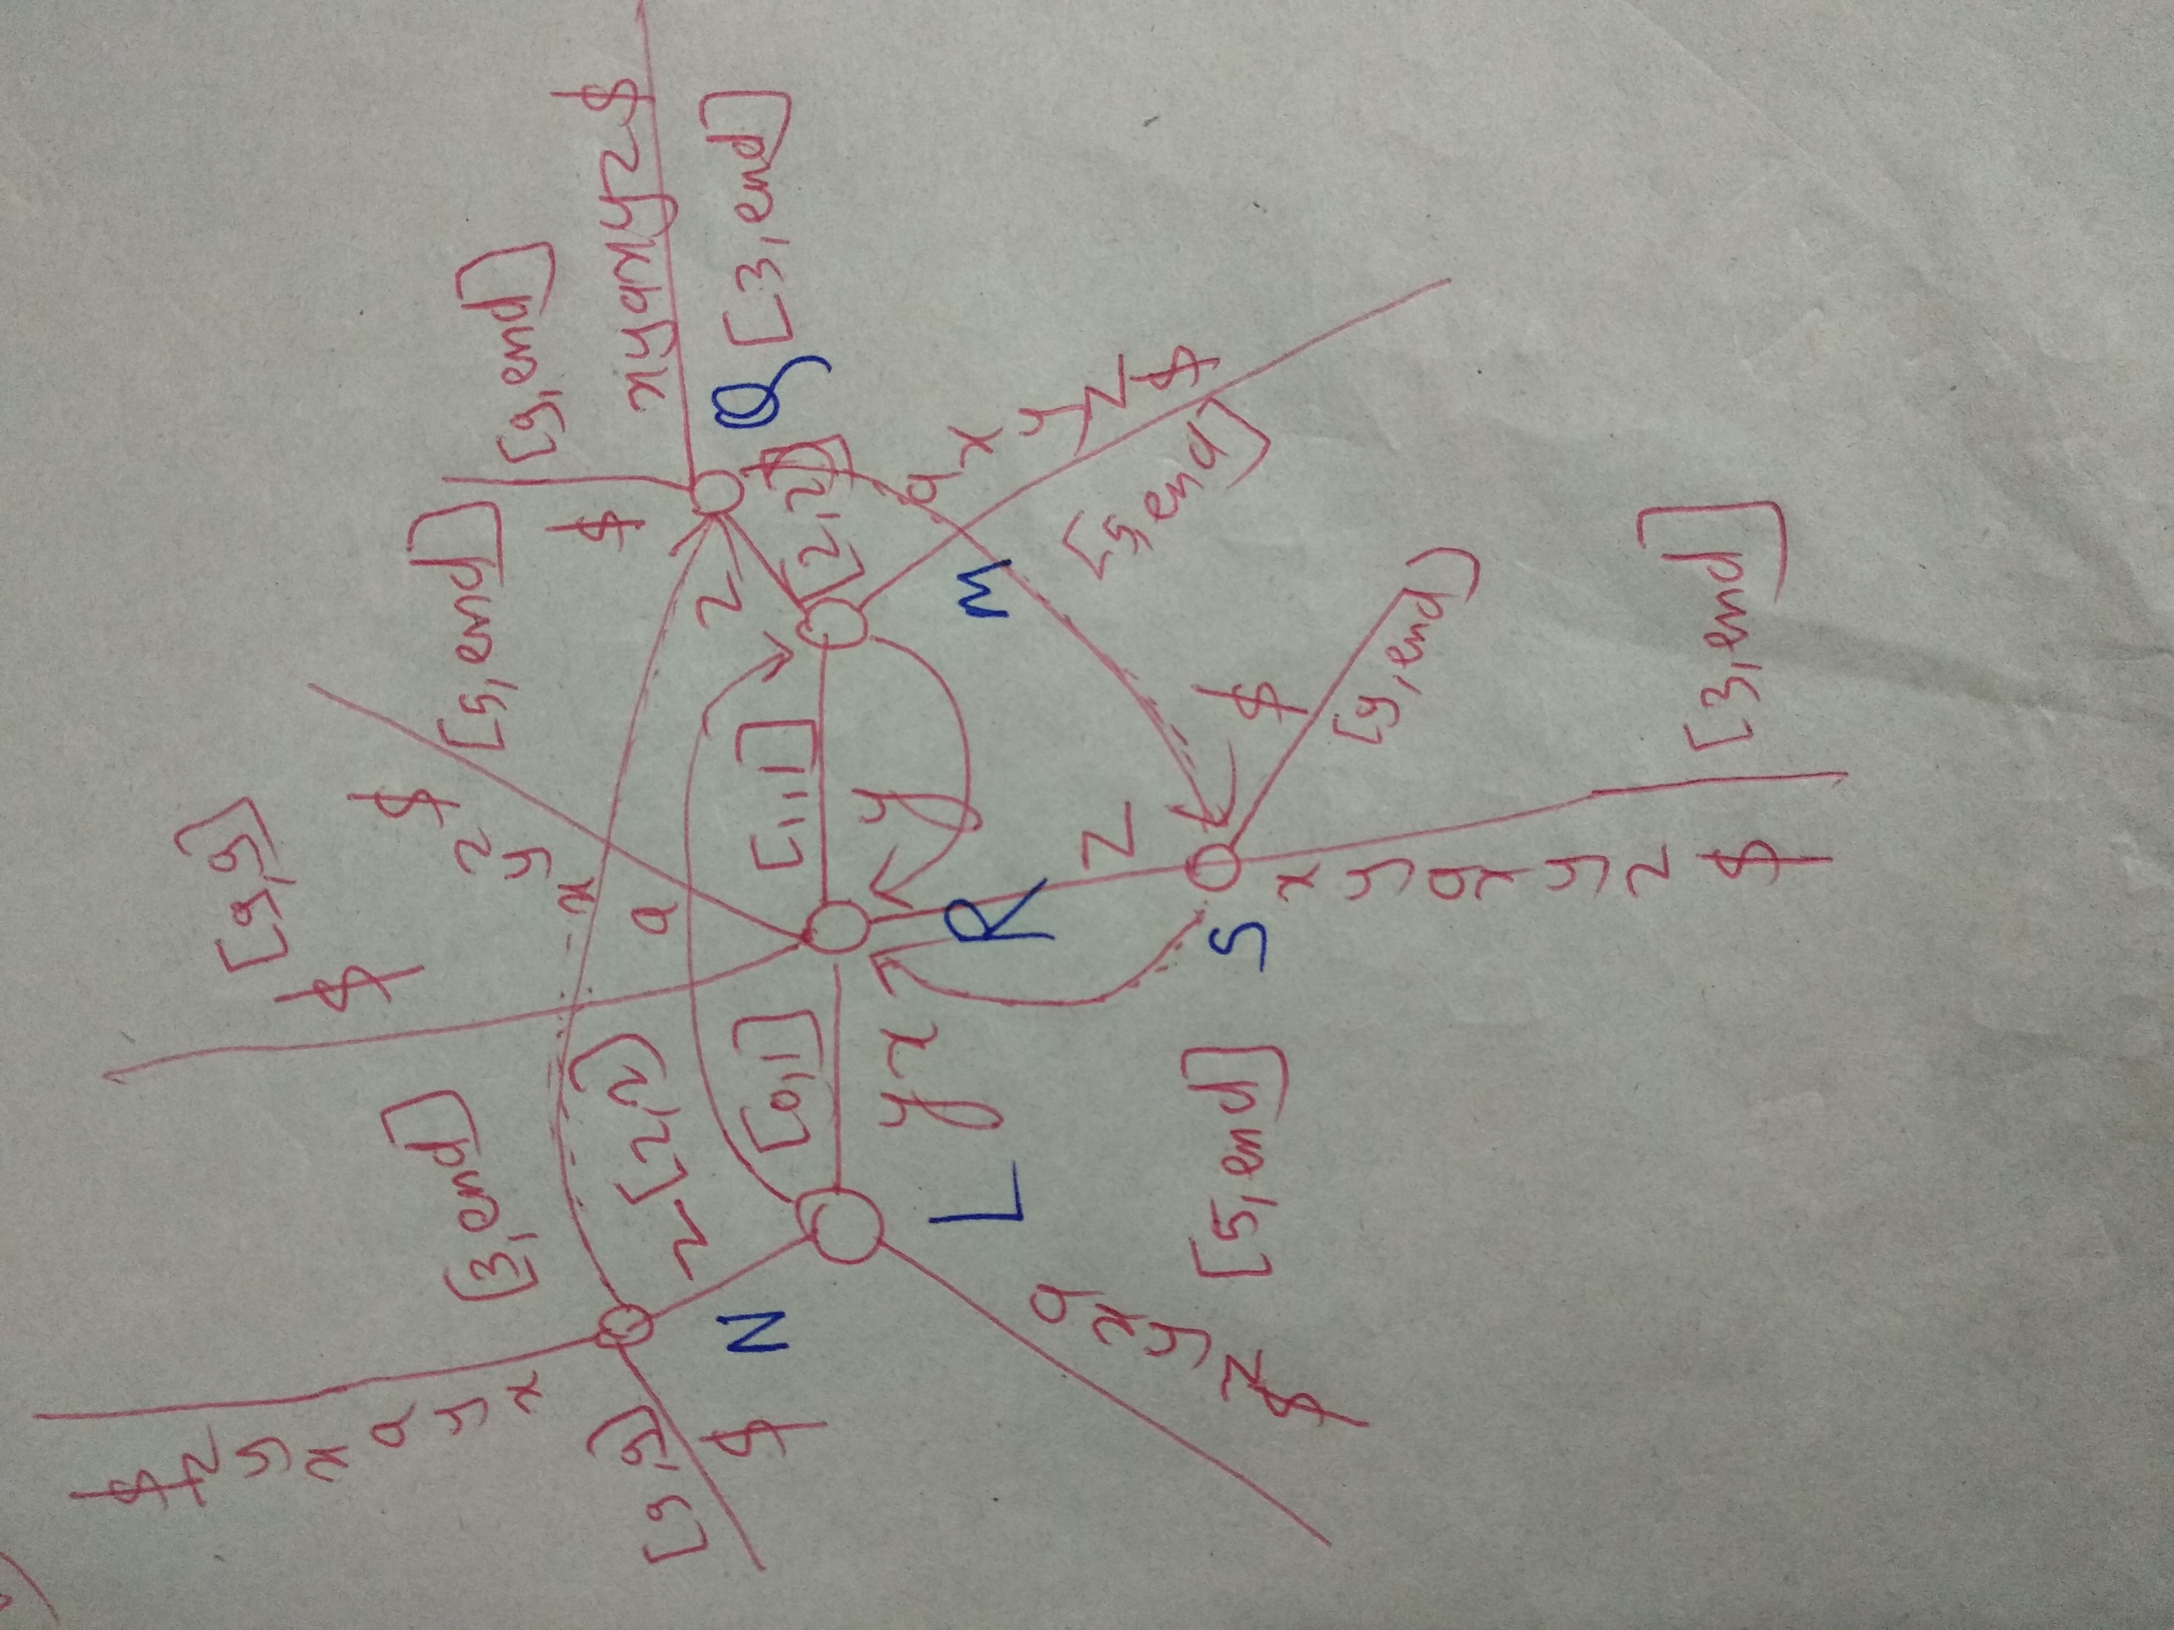
Step 4 Step 5

Slide 15
Applications(Explanations):-
1) Check whether q is a suffix of T: Follow the path for q starting from the root.
If you end at a leaf at the end of q, then q is a suffix of T.
2) Check whether q is a substring of T: Follow the path for q starting from the root. If you exhaust the query string, then q is in T.
3) Count number of occurrences of q in T: Follow the path for q starting from the root. The number of leaves under the node you end up in is the number of occurrences of q.
4)Find the longest repeat in T: Find the deepest node that has at least 2 leaves under it.
5)Find the lexicographically (alphabetically) first suffix: Start at the root, and follow the edge labeled with the lexicographically (alphabetically) smallest letter

Slide 16
THANKS

